Slide 1
Product summary

Slide 2
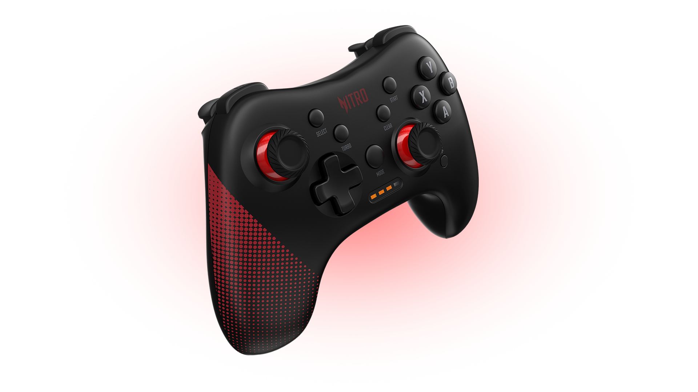
NITRO GAMING CONTROLLER
Model Name
NGR200

Slide 4
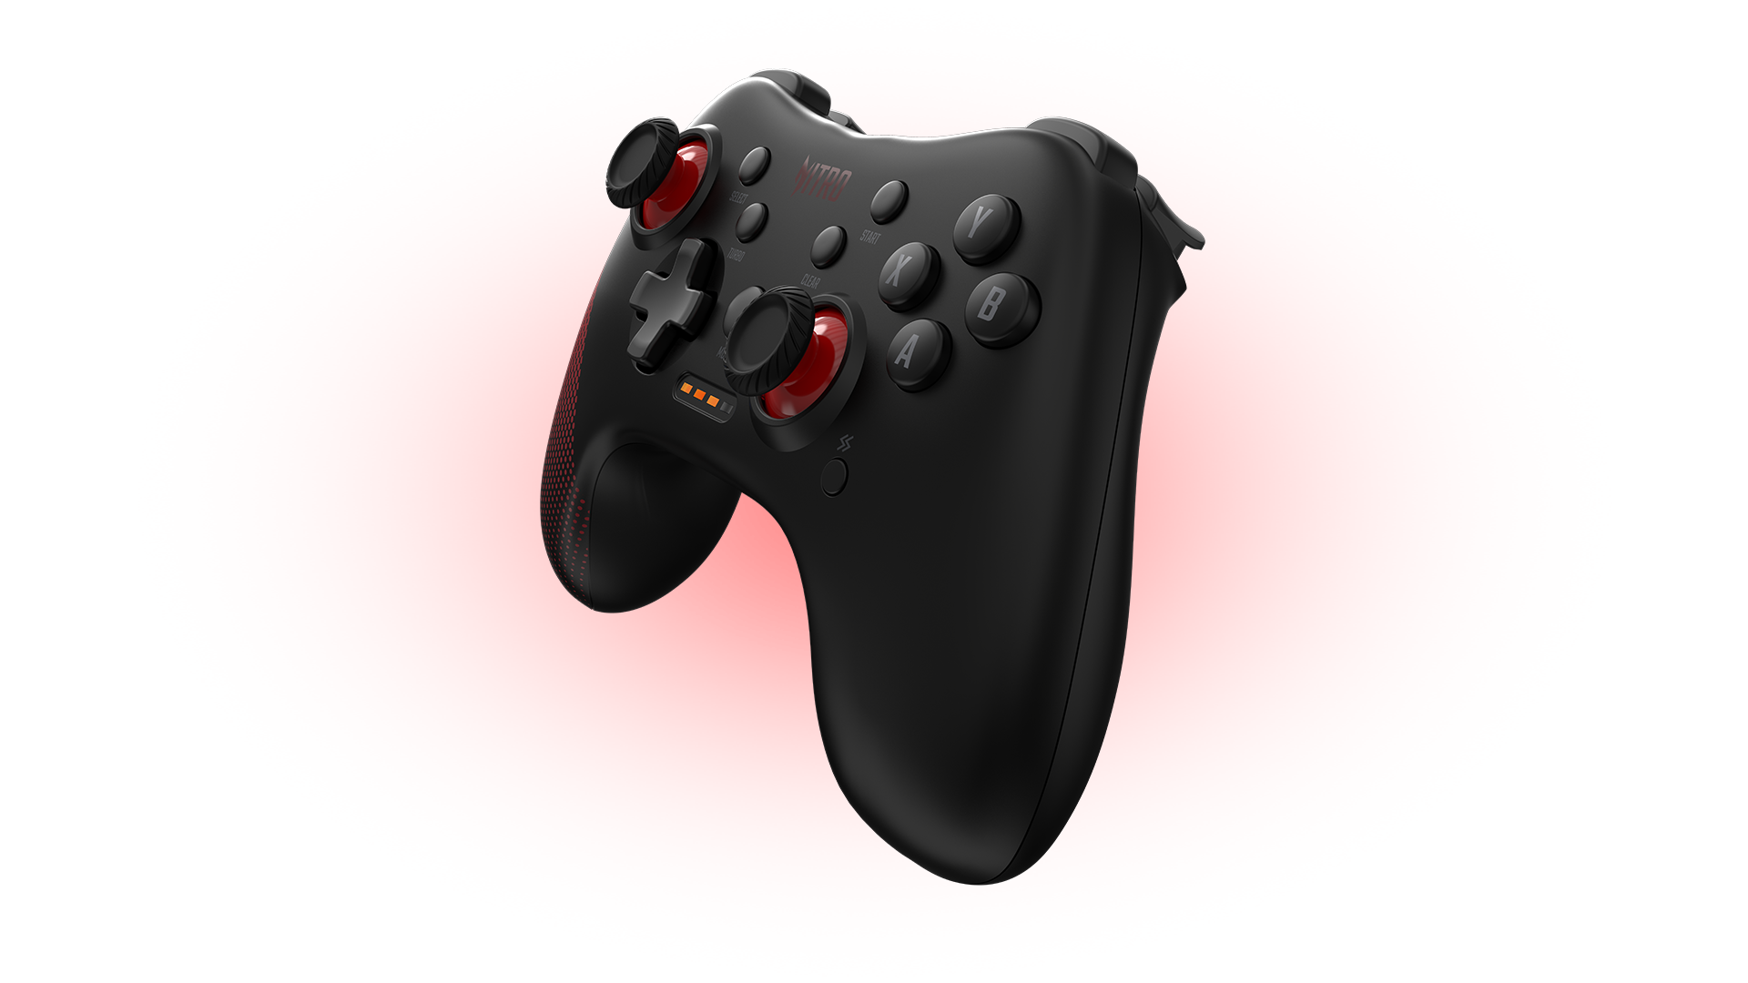
NITRO Gaming Controller
The ever-comfortable Nitro Gaming Controller works flawlessly with your PC and android devices and includes a turbo button for all your button mashing needs!

Slide 5
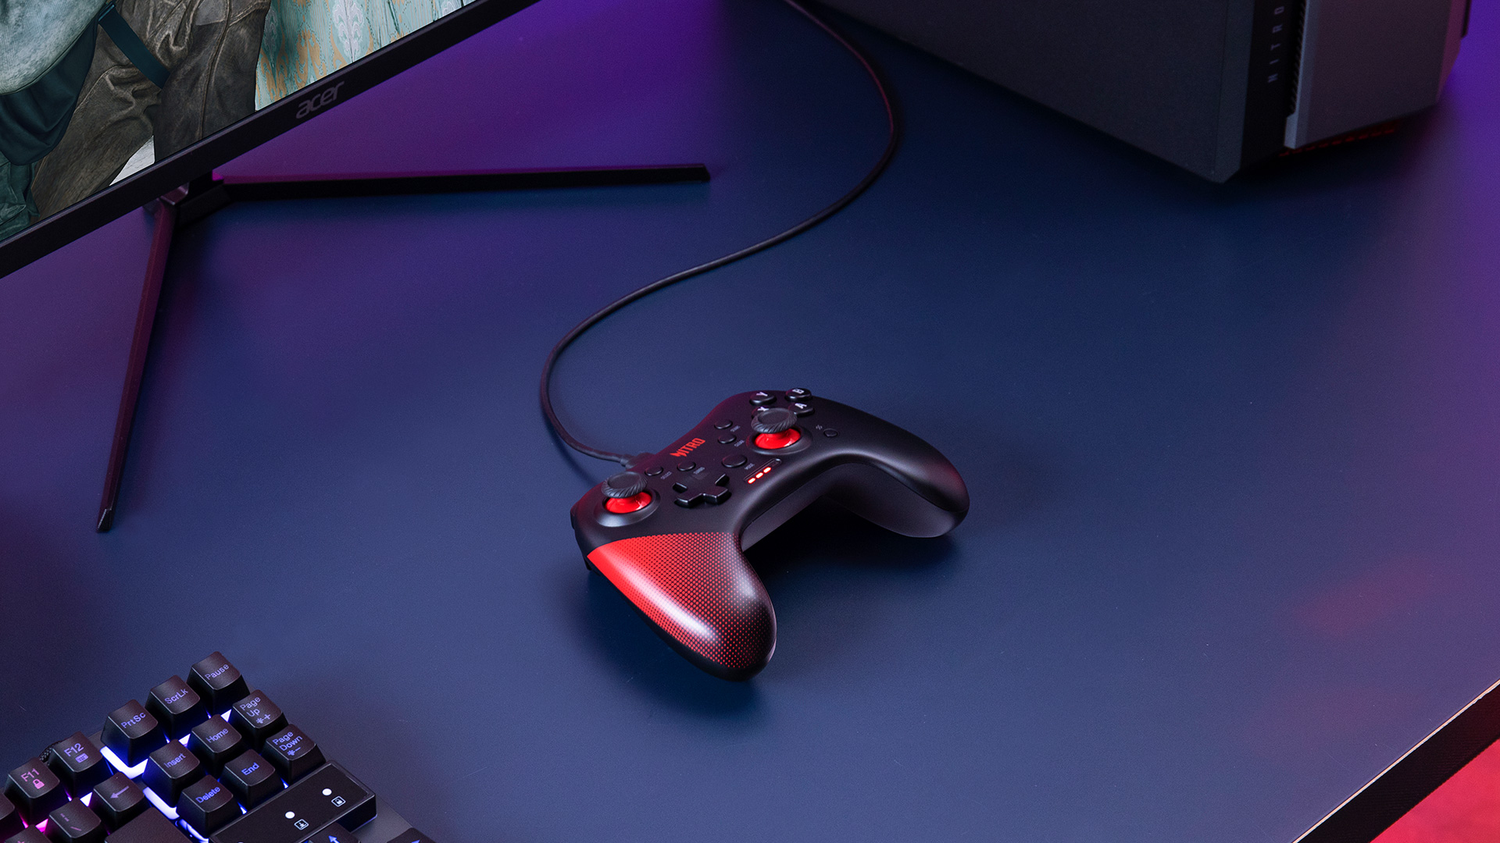

Slide 6
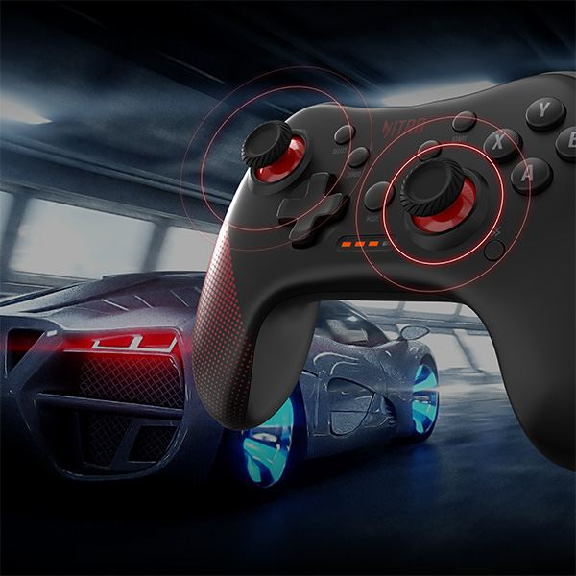
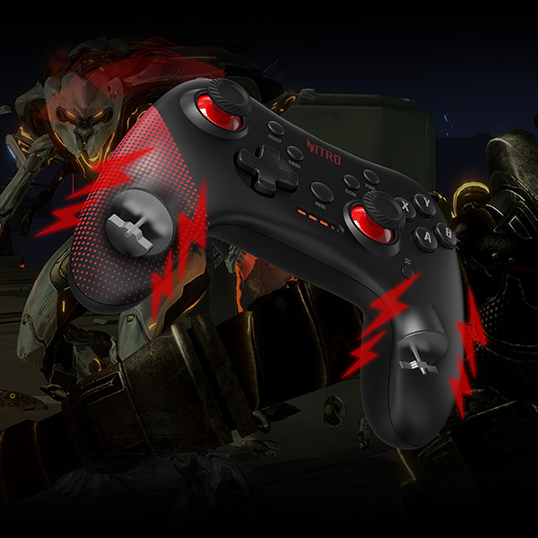
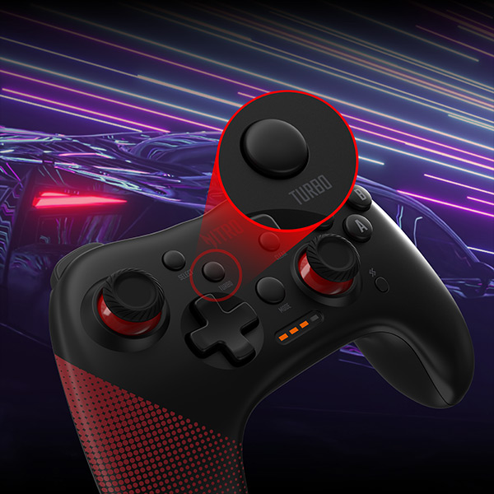
1. It Just Feels Right
Grip the controller in both hands, place your thumbs on the carefully placed asymmetrical analog joysticks, and prepare to lose yourself in the exquisiteness of the moment as the screen pixels come to life.
2. Getting Along with Windows & Android
Free up a USB port, pop it in, and you’re all set! Compatible with Windows¹ and Android² devices and has support for XInput (including vibration).
Requires a minimum of Windows 7 or above.
Use latest update from your Android device manufacturer (Android 4.2 or above). Applies to Android smart phones and TVs.
3. Gotta Go Fast
See that turbo button there in the photo? This little guy blasts you into Turbo Mode³ by simulating your controller's input button of choice as though you were constantly pressing it.
Turbo is a feature that allows for a button press to be indefinitely until turned off. Pressing or holding down the ‘input’ button and then pushing ‘Turbo’ will place the device in ‘Turbo Mode.’

Slide 7
Design | Comfortable grip
Features | USB-C Interface
 | 17 Keys
 | XInput
 | Dual Vibration Motors Inside
 | Support Windows and Android
Product Dimension | 152 (L) x 115 (W) x 58 (H) mm
Product Weight | 172g ± 5g (without cable)
Software | N/A
Connector Type | USB Port
Platform Compatibility | Windows 7 and above Android 4.2 and above
Cable Length | 2M
Package Contents & Dimension | Nitro Gaming Controller
 | Warranty Booklet
 | Quick Start Guide
 | USB-C to USB-A Cable
 | USB-A to USB-C Adapter
 | 172 (L) x 147 (W) x 64 (H) mm
Specifications may vary depending on region.

Slide 8
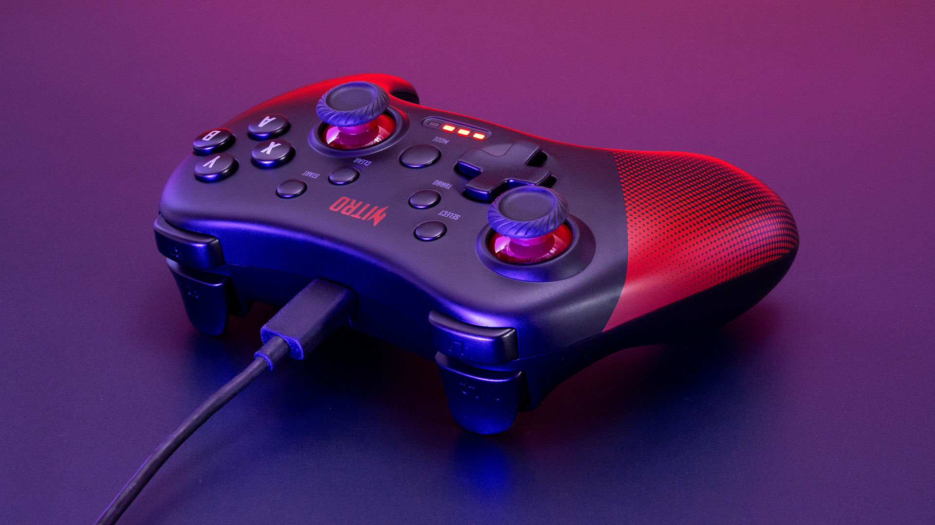

Slide 9
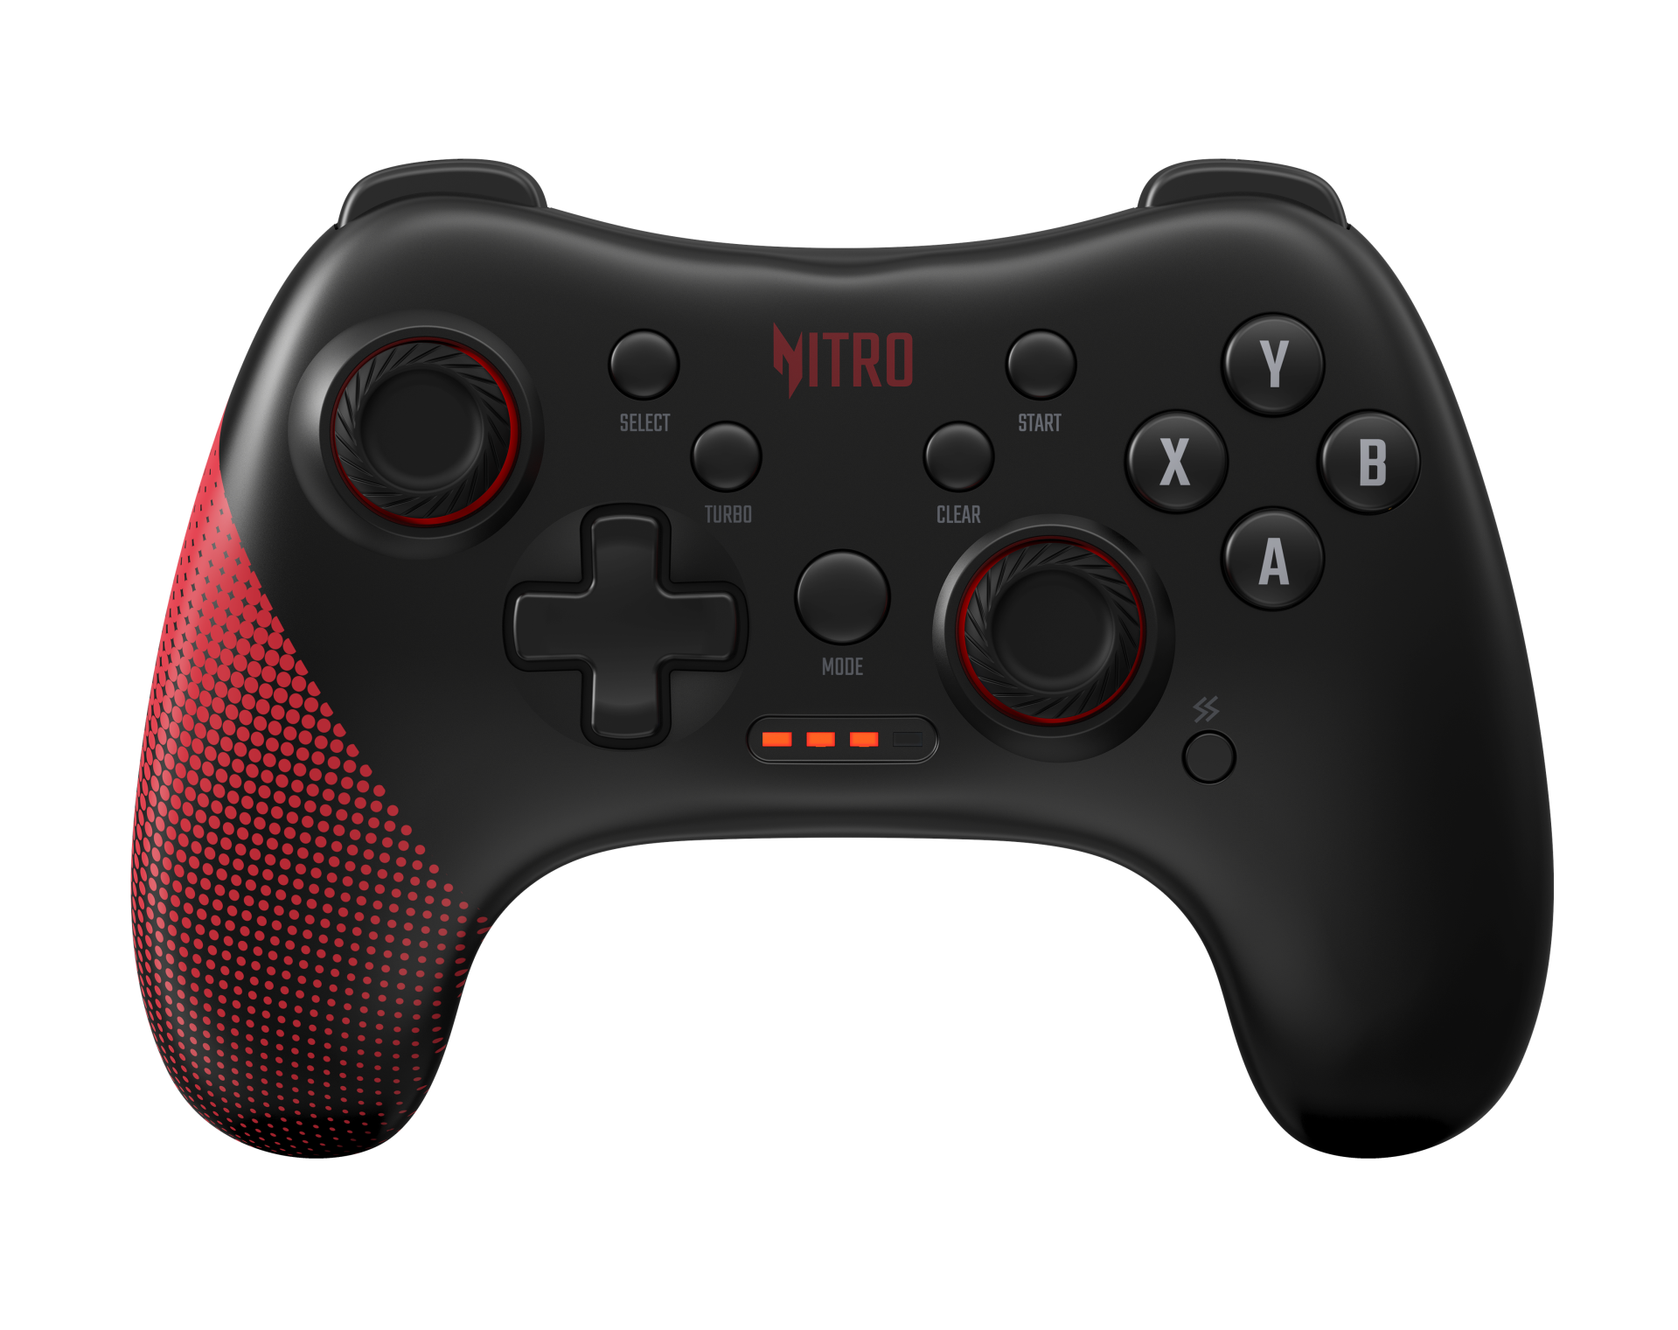
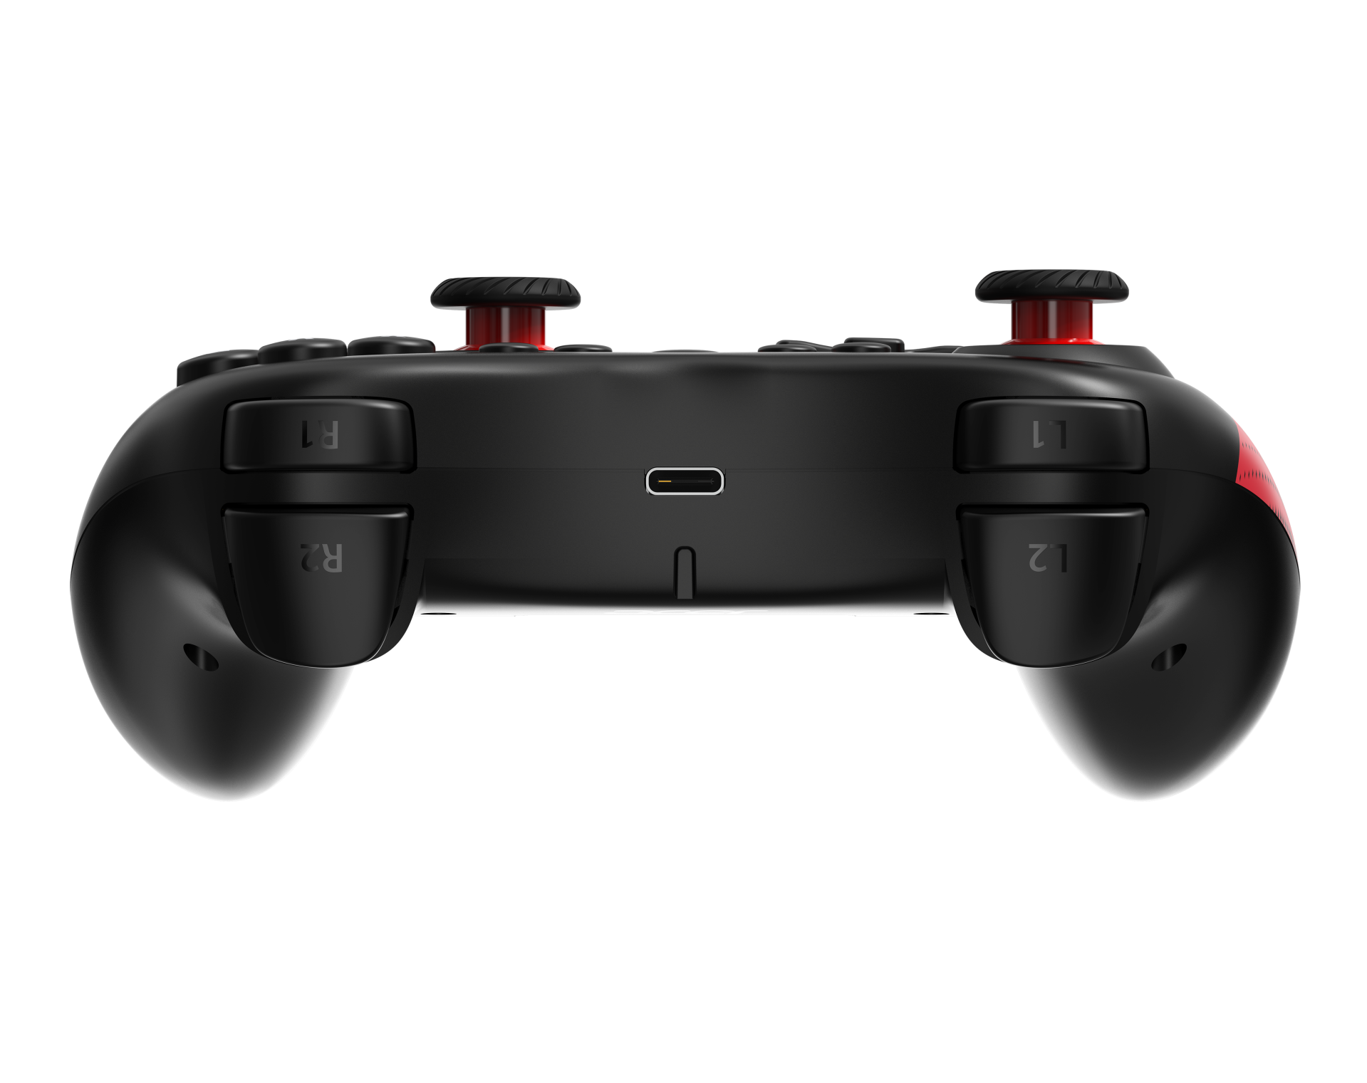
Mode
Clear
Turbo
Select
Start
Action Buttons
Joystick
Directional
Pad
Joystick
Vibration
LED Indicators
USB-C Port
Color | Black & Nitro Red
Material | ABS

Slide 10
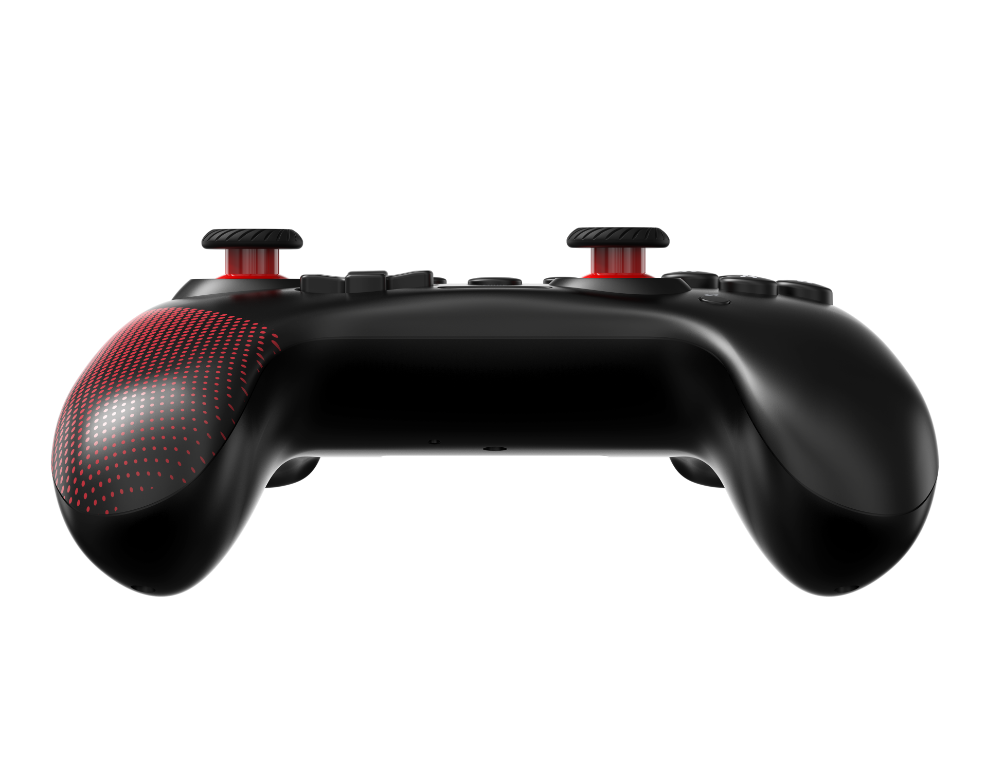
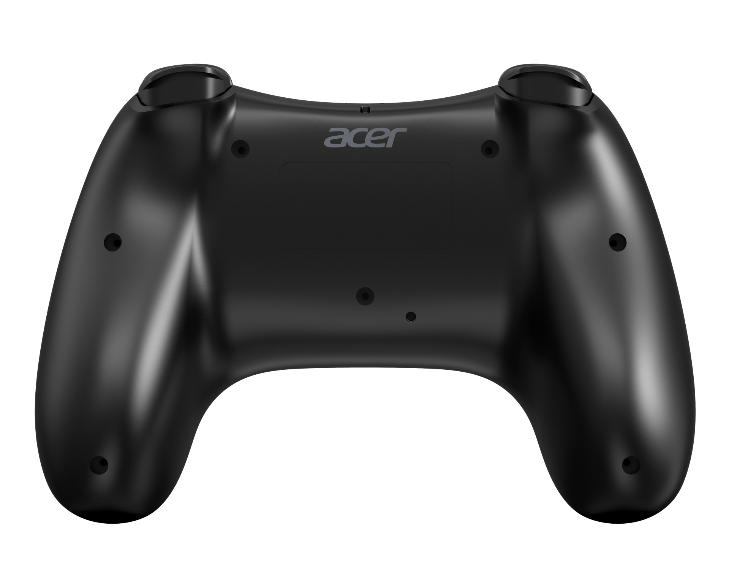
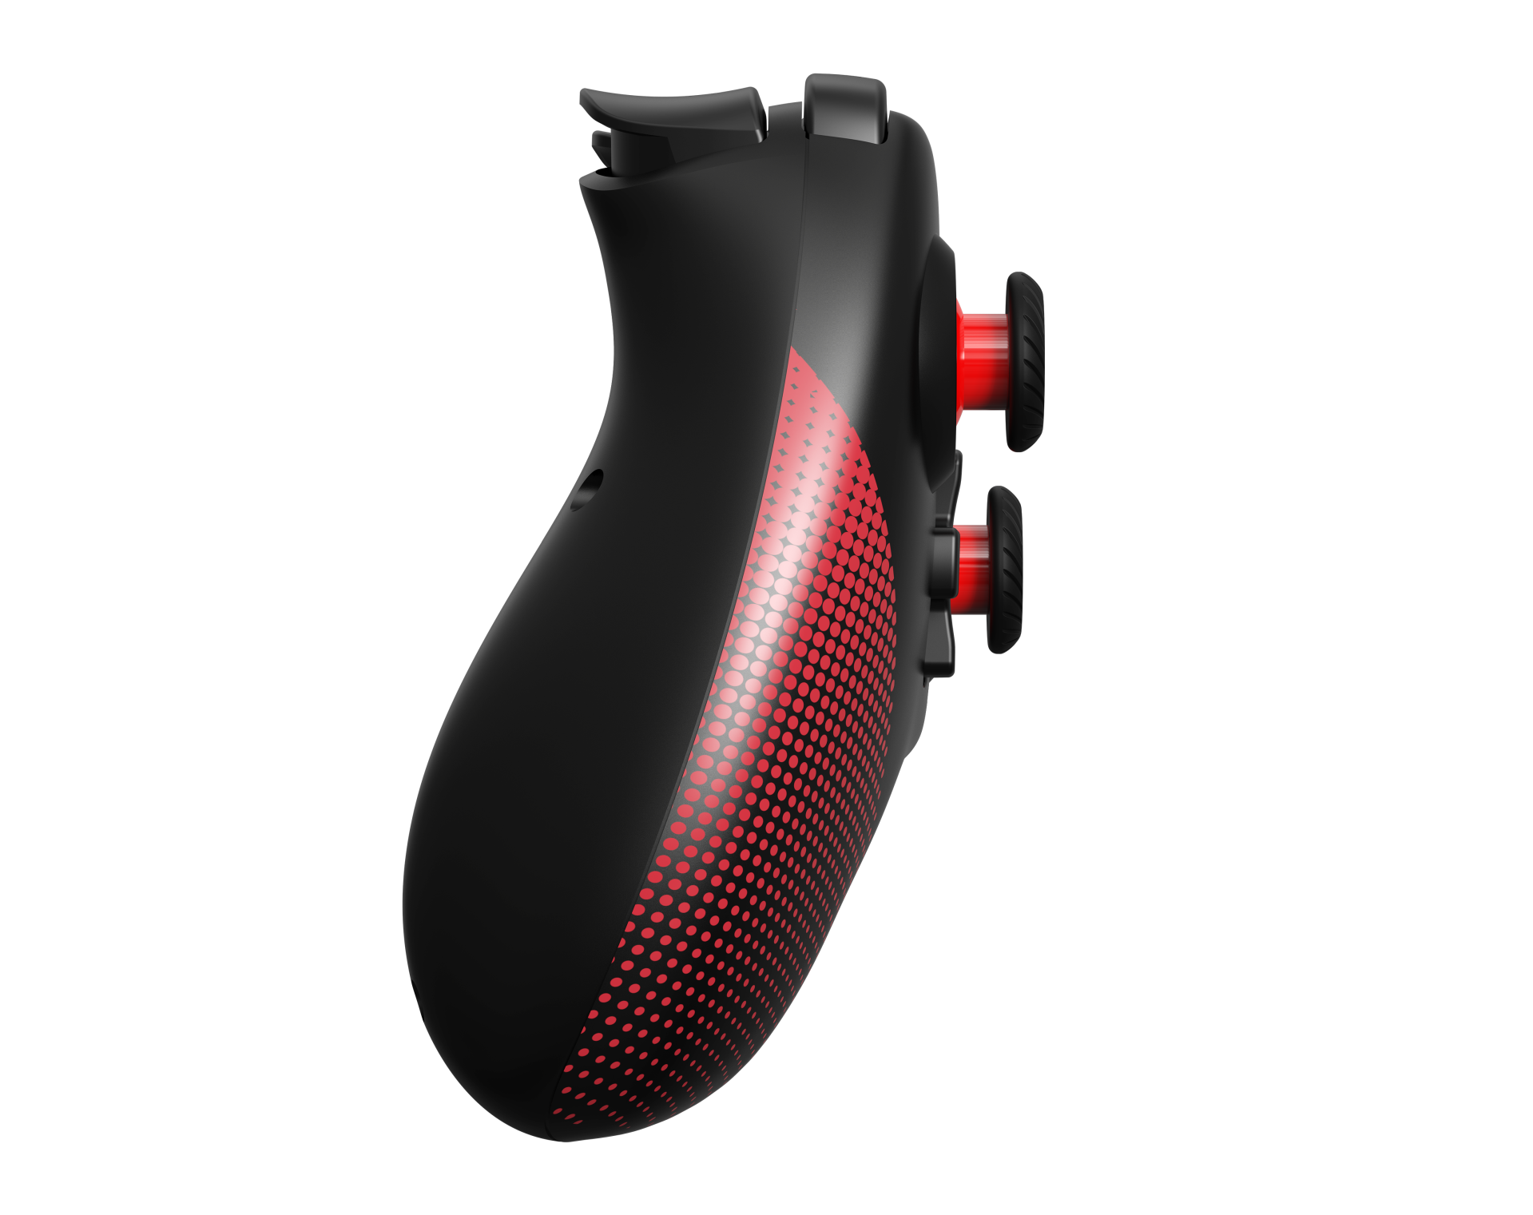
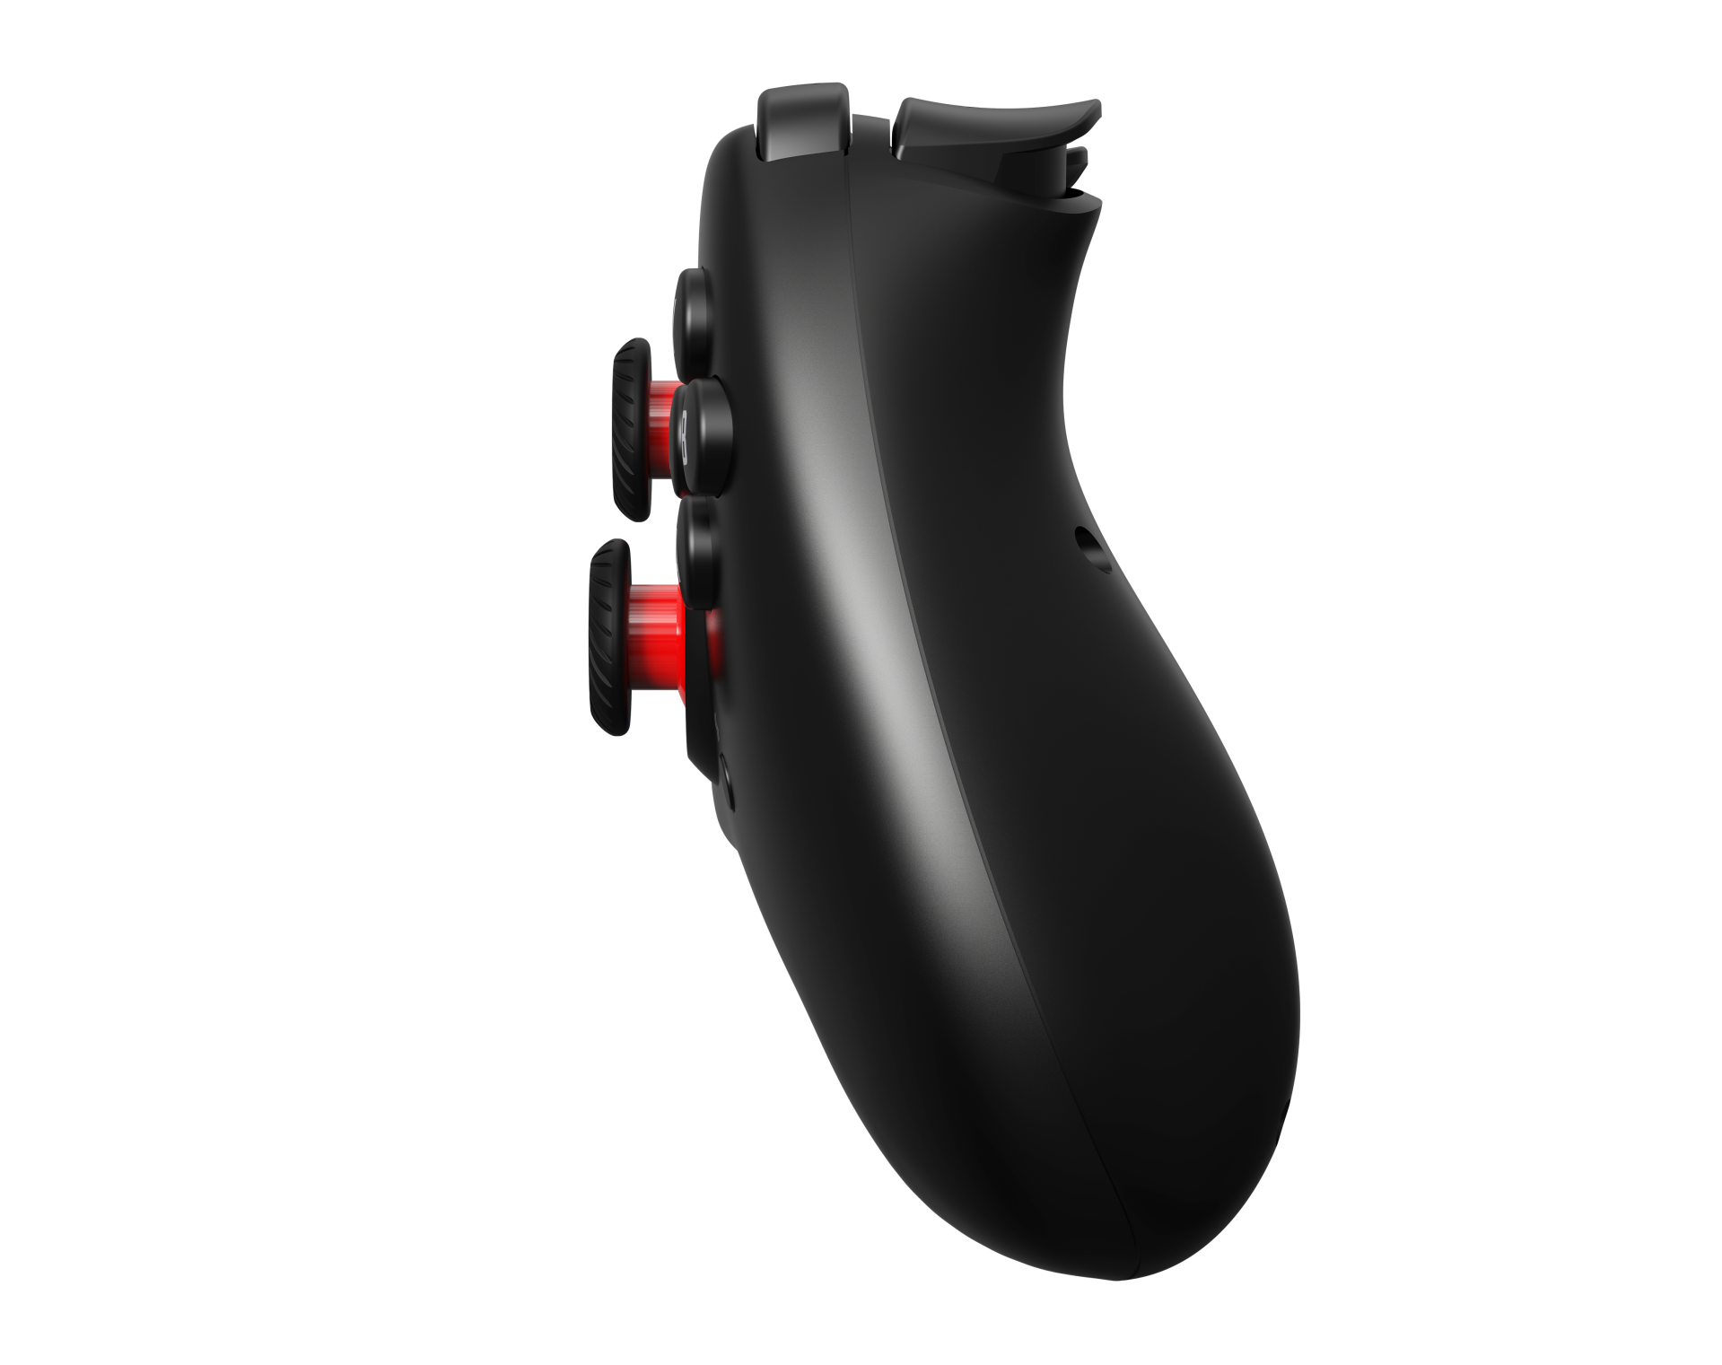

Slide 11
